Slide 1



Slide 2


Slide 3
Outlet box

Slide 4




Slide 5
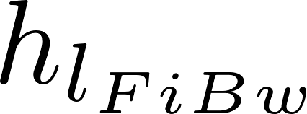


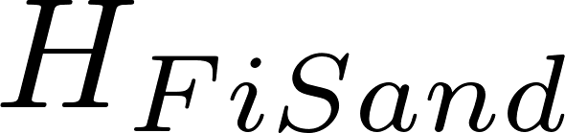
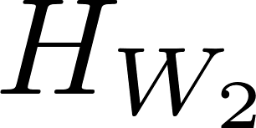

Slide 6
Filter type | Velocity (mm/s) | Cleaning | Max (NTU) | pC* | Area (m²) for 1 L/s
Dynamic | 0.4 |  |  | 0 | 2.5
Roughing¹ | 0.17 | 5.5 mm/s downflow |  | 0.5² | 5.9
Slow | 0.04 | Scrape surface | 10 | 0.8² | 25
Multistage | 0.03³ |  | 100⁴ | 1.3 | 33.4
Rapid | 0.7 – 2.8 | 11 mm/s backwash | 5⁵ | 1 | 0.55
Entrance | 8 |  |  |  | 0.125
Flocculation | 4 |  |  |  | 0.25
Sedimentation | 1 |  |  | 2.5 | 1
Floc Hopper | 5 |  |  |  | 0.2
Stacked Rapid | 1.8 x 6 | 11 mm/s backwash | 3⁶ | 1⁶ | 0.093
AguaClara | 0.6³ |  | 1000⁵ | 3.5 | 1.67
1 Roughing is up flow in layers
2 Based on table 5.7 https://confluence.cornell.edu/download/attachments/90755680/FiME+CINARA.pdf
3 Net velocity for scaling total plan view area of facility.
4 This assumes a target of 5 NTU in the effluent
5 Assumes a target of 0.3 NTU in the effluent (based on performance of the Atima plant)
6 Data from Tamara.
The 32 L/s plant at San Nicolas has 5.5 m² per L/s (includes chemical room, bathroom, office , etc.)

Slide 7
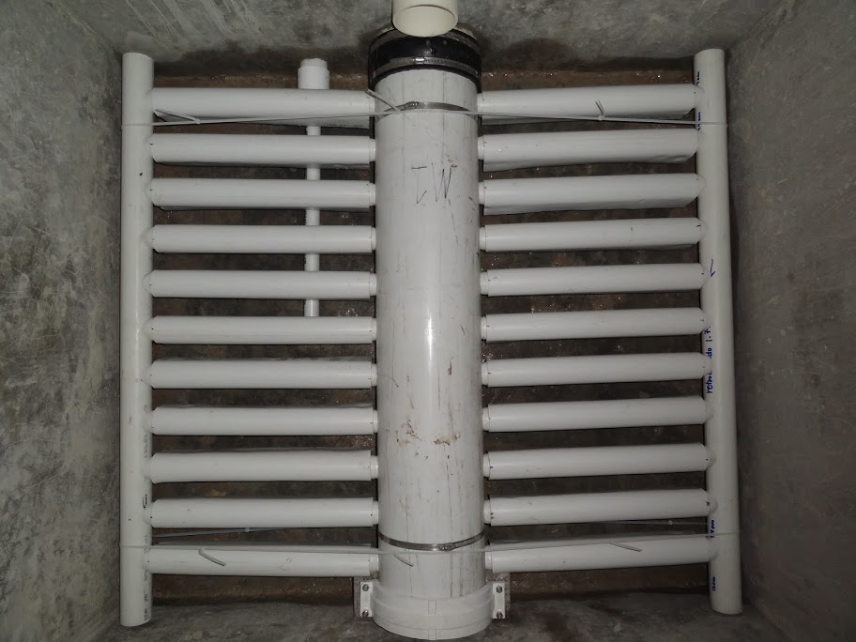

Slide 8



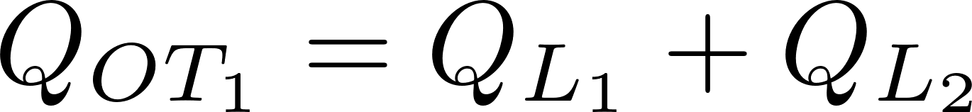
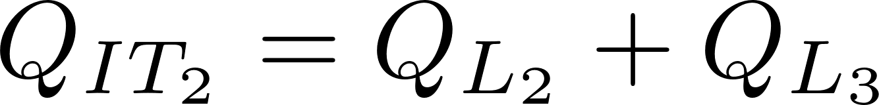
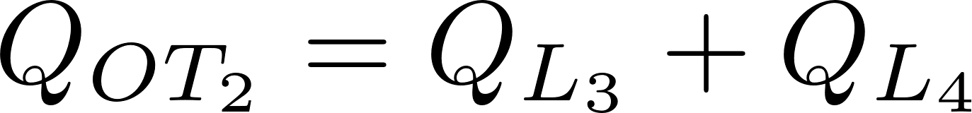

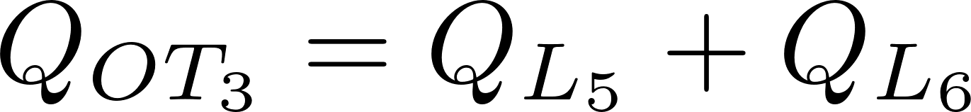
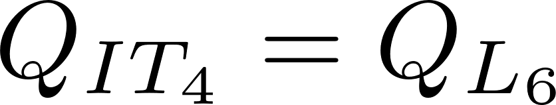
Trunk 1
Trunk 2
Trunk 3
Trunk 4
Notes:
Schematic of filter. Explains why maximum flow in branches is two times the flow through each layer.

Slide 9


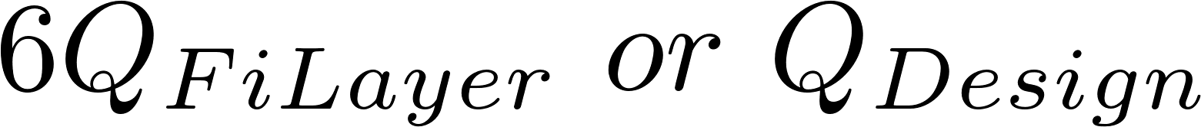
Notes:
Schematic of filter. Explains why maximum flow in branches is two times the flow through each layer.

Slide 10









Notes:
Schematic of filter. Explains why maximum flow in branches is two times the flow through each layer.

Slide 11
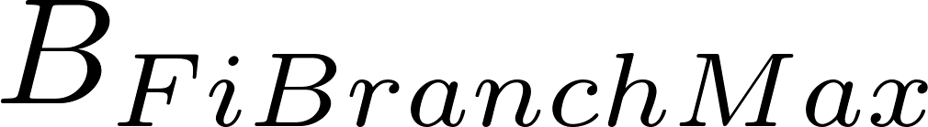
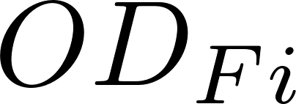
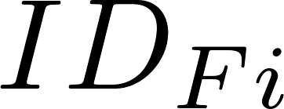



Slide 12
Flow Direction
Notes:
Branch paths!

Slide 13
Flow Direction
Notes:
Branch paths!

Slide 14
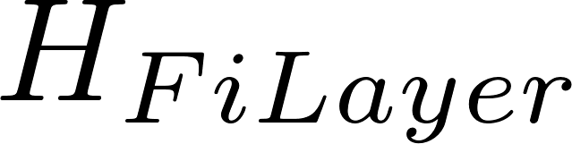

Slide 15
Notes:
Paths!

Slide 16





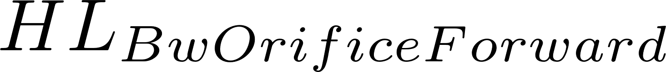




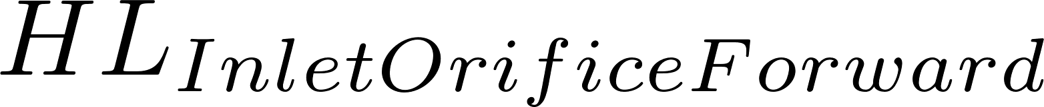





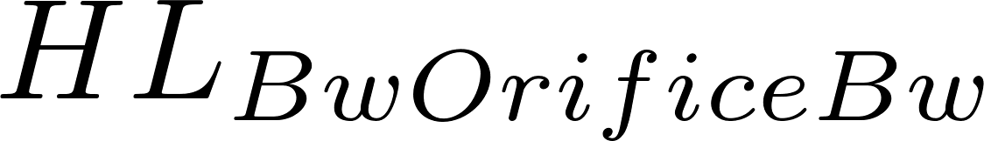


Slide 17
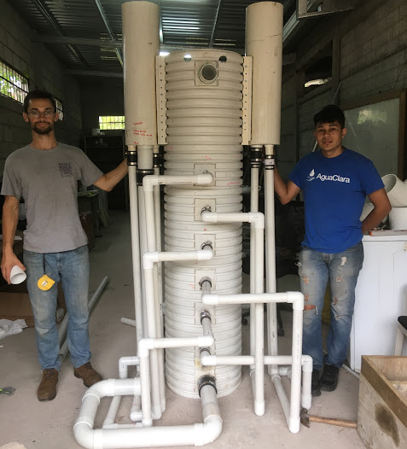
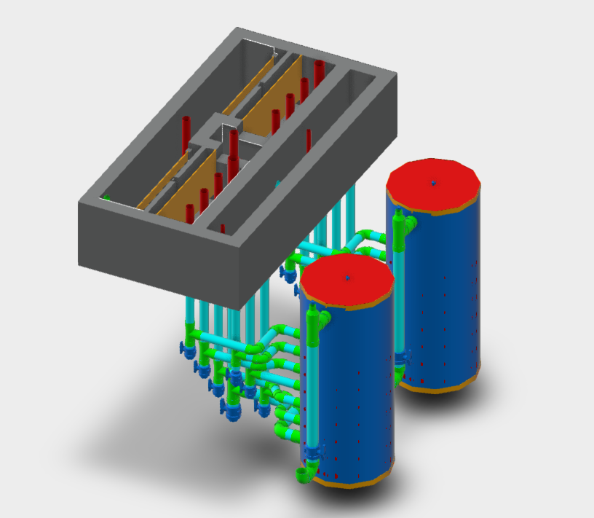

Slide 18

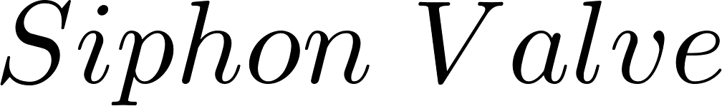
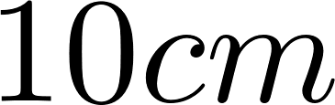
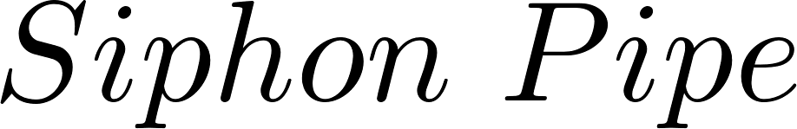

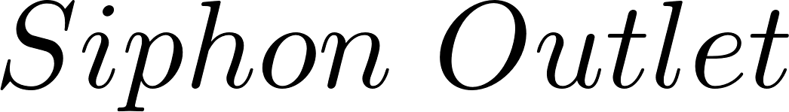


Slide 19
(feature) | EStaRS for plantita | EStaRS “concrete” | EStaRS “Micky Mouse” | OStaRS
Sand layer height | 15cm | 20cm | 20cm | Function of trunk diameters, 20cm min
Signal for backwash | 60cm head loss | 75 cm head loss | 75 cm head loss | 80 cm head loss
Entrance tank material | Concrete/PVC | Concrete | PVC | Concrete
Acceptable flows per 1 filter (L/s) | <.75 | .764, 3.07, 7.024 | .764, 3.07, 7.024 | >8

Slide 20


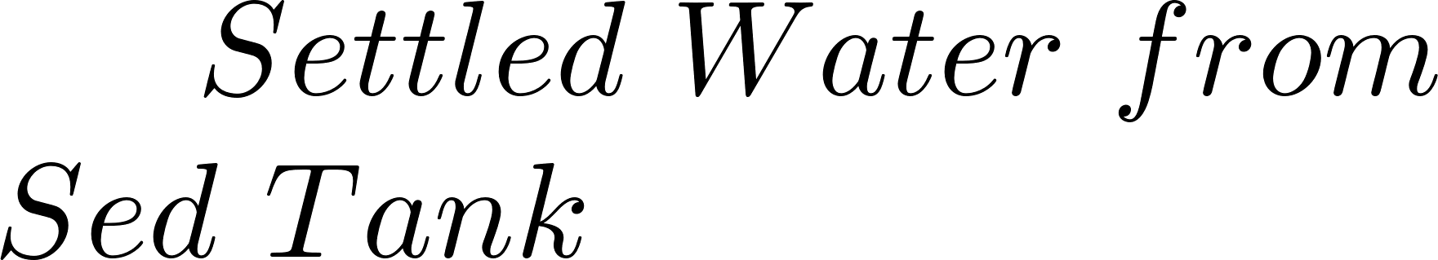





Slide 21



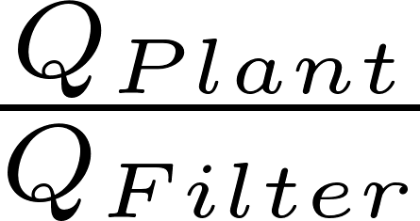
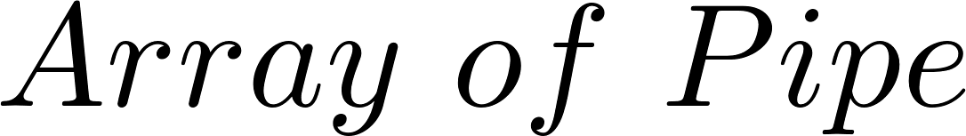



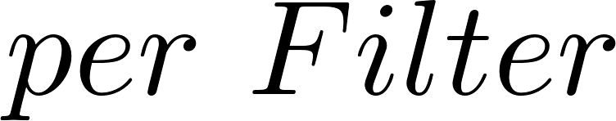

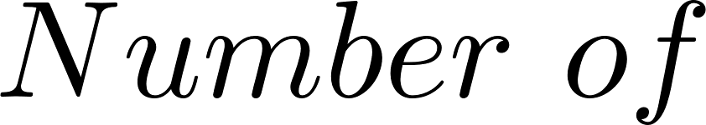




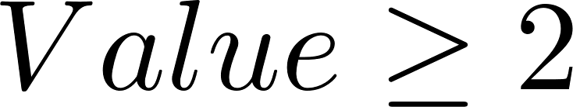

Slide 22
